Slide 1
OFDM system and
PAPR Reduction Techniques in OFDM
Under the guidance
of
Mr. A.Ch.Madhusudanarao
Presented by
B081195_G.Suresh
B081447_K.Mounika
04/12/13

Slide 2
Outline
Problem Statement
Method of Solving
Theory of OFDM
Background work
Peak to Average Power Ratio
Methodology Adopted
Results and Conclusions
References

Slide 3

Problem Statement
OFDM signal – superposition of a large number of modulated subcarriers - may exhibit a high instantaneous signal peak with respect to average signal level
PAPR is proportional to # of subcarriers
High Peak to Average Power Ratio
  - Increases complexity of the ADC and DAC
  - Reduces efficiency of the RF power amplifier

Slide 4
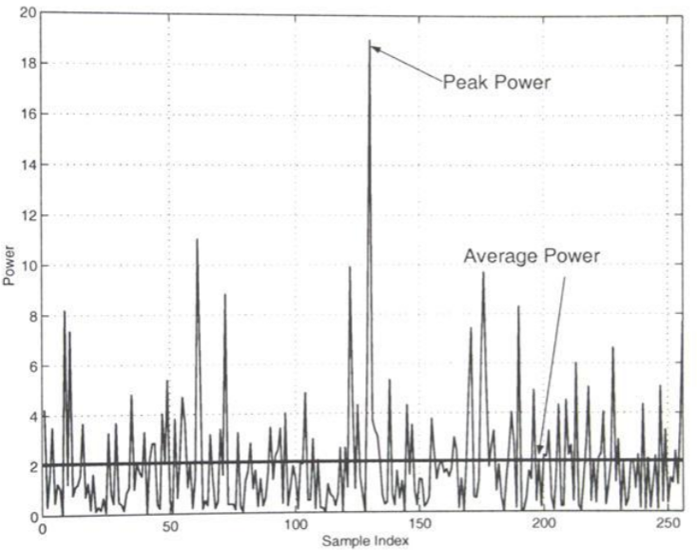
Problem Statement

Slide 5
Method of Solving
Single Carrier
Multi Carrier
OFDM
Signal Scrambling
techniques
PAPR
Signal Distortion
techniques
Block Coding
Selective Level Mapping
Partial Transmit Sequence
Tone Reservation
Signal Clipping
Peak Windowing
Envelop Scaling

Slide 6
Spectrum comparison for same data rate transmission
Single carrier
frequency
Multi carrier
frequency
OFDM
frequency

Slide 7
What is OFDM?
Many orthogonal sub-carriers are multiplexed in one symbol
  Why multicarrier?
  What is orthogonality?
  How modulated & multiplexed?
  How many sub-carriers to choose?
  Why Synchronization for OFDM?
  What are the merits & demerits of OFDM?
  What kind of applications?

Slide 8
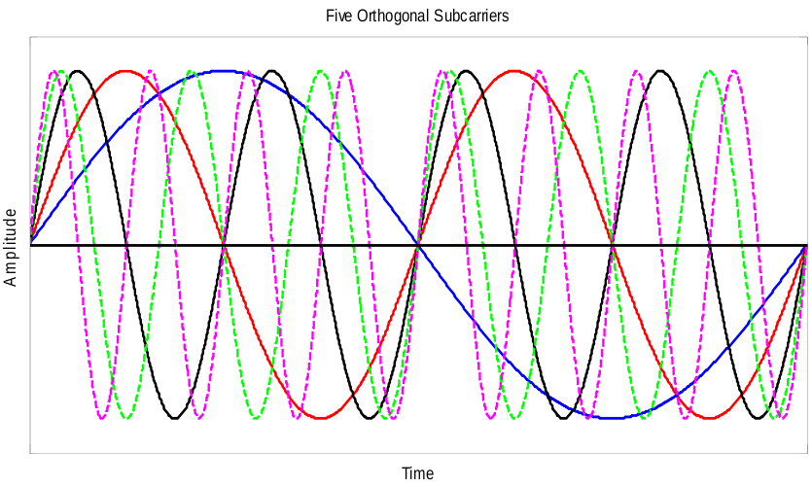
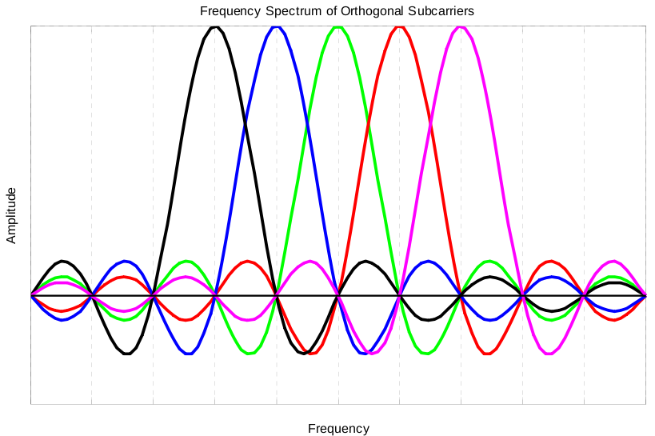
OFDM Spectrum

Slide 9
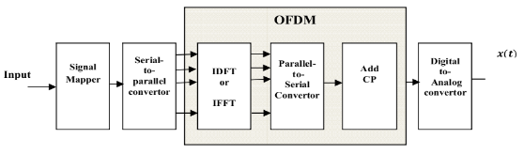

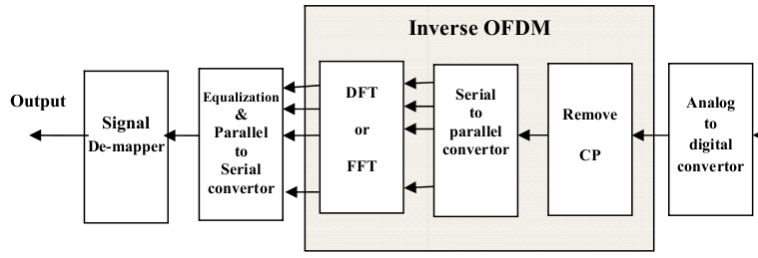


Work flow of OFDM
MultiPath
Fadding
Channel

Slide 10
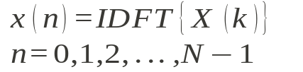




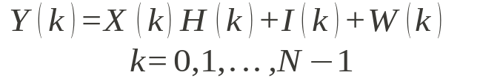
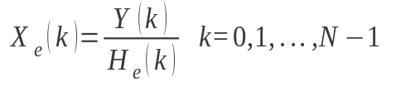
System Architecture
1
Input to Time Domain
2
Guard Interval
3
Channel
4
Guard Removal
5
Output to Frequency Domain
6
Output
Channel
ICI
AWGN
7
Channel Estimation
Estimated Channel

Slide 11
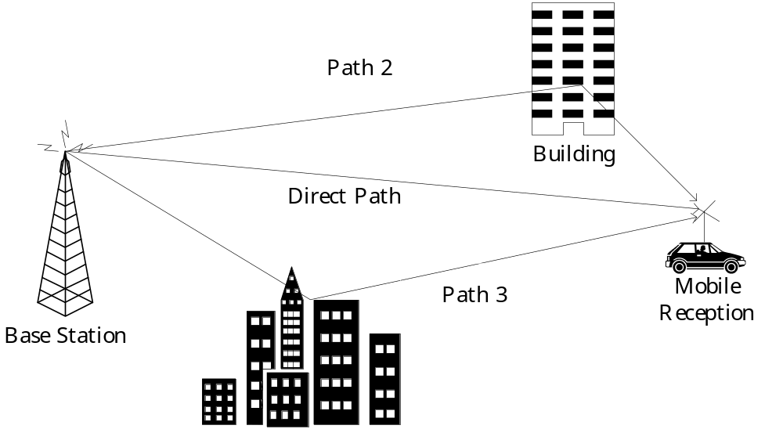
Multi-path
Delayed wave causes interference

Slide 12
Multi-path effect
Symbol k-1
Symbol k
Symbol k+1
No multi-path
T=1/f_{０}
Sampling Period
Multi-path
Direct
Delayed
Sampling Period
Inter symbol interference (ISI) occurs due to Multi-path condition.
Only initial samples are being subjected to ISI.
Add Guard Interval to avoid ISI.

Slide 13
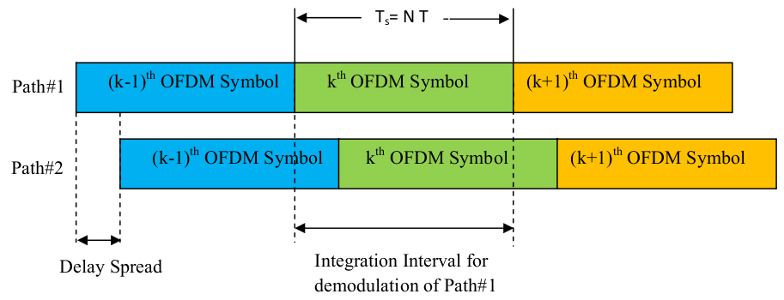
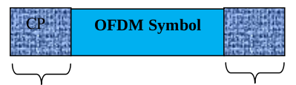
Guard Interval T_{g}
Add Cyclic Prefix

Slide 14
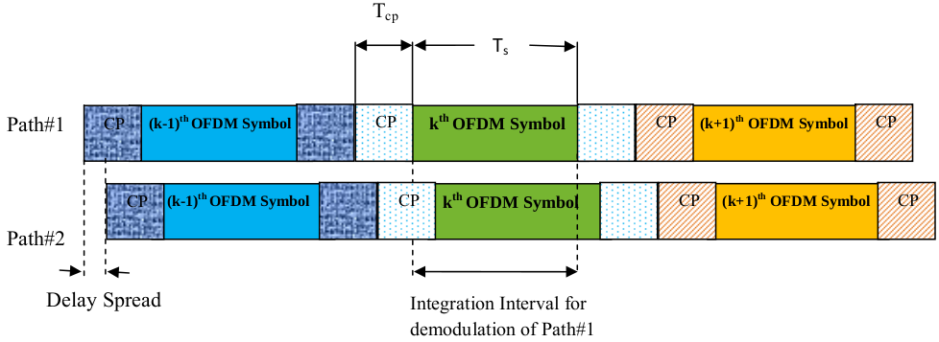
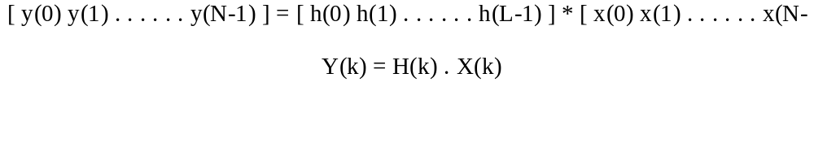
Cyclic Prefix
Loss in efficiency is the ratio of CP and total OFDM symbol

Slide 15
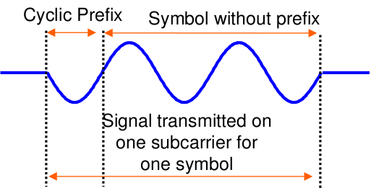
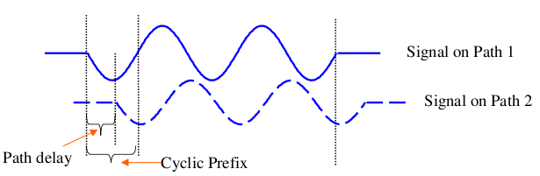
Cyclic Prefix
If multipath delay < CP
No inter symbol or inter carrier interference
Amplitude may increases or decreases .

Slide 16
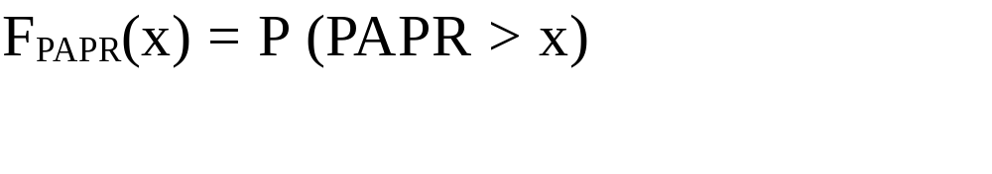
Peak to Average Power Ratio (PAPR)
Crest Factor
Single Carrier system
OFDM
  Base Band system
  Band Pass system
  PAPR is proportional to # of subcarriers
  Characterized by CCDF

Slide 17


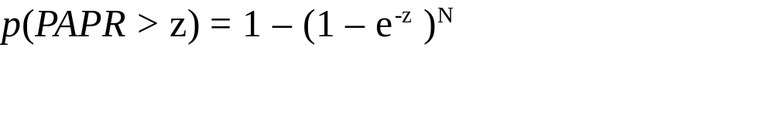


Distribution of PAPR
Power Distribution
Assuming all the samples are mutually uncorrelated
Cumulative Distribution Function (CDF)
Complementary Cumulative Distribution Function (CCDF)

Slide 18
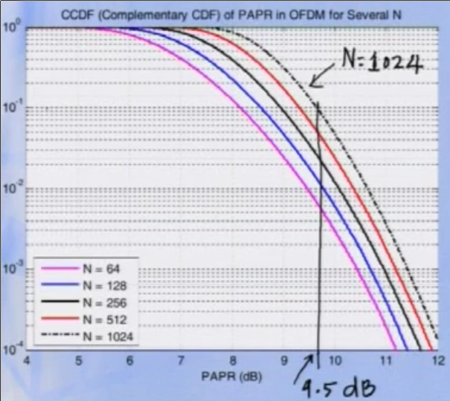
Complementary Cumulative Distribution Function(CCDF)

Slide 19
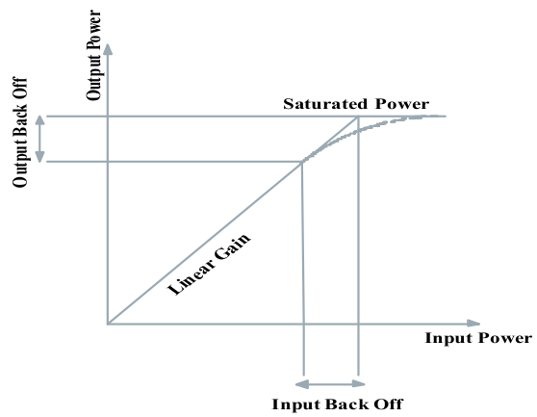
Effect of Peaks
Large peaks cause saturation in power amplifiers, leading to intermodulation product among subcarriers.
Loss of Orthogonality → ICI

Slide 20
Criteria for PAPR Reduction Method selection
Side effects
Avg power increase
Implementation complexity
No bandwidth Expansion
Without additional power needed.

Slide 21
Distortion Techniques
Clipping
Peak Windowing
Peak Cancellation

Slide 22
Scrambling Techniques
Based on scrambling each OFDM symbol with different scrambling sequences.
Scrambling Schemes
  Adaptive Subcarrier Selection
  Selective Mapping
  Partial Transmit Sequence
  Block Coding

Slide 23
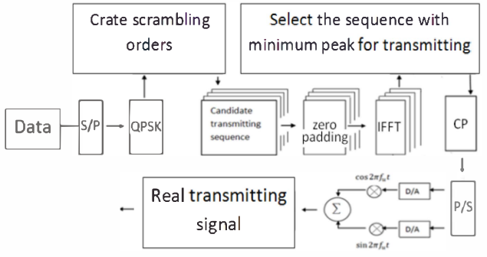
Scrambling Techniques
Overhead increases at Tx and Rx

Slide 24
Clipping
Non-Linear technique
Simple & less expensive
Can't get original signal
MMSE(Minimum Mean Square Error)

Slide 25
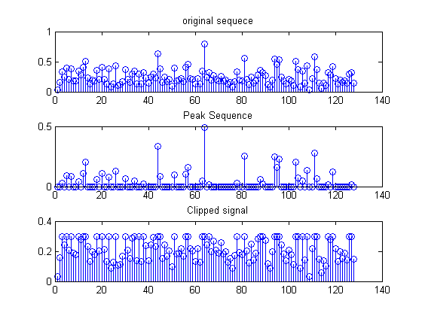
Results

Slide 26
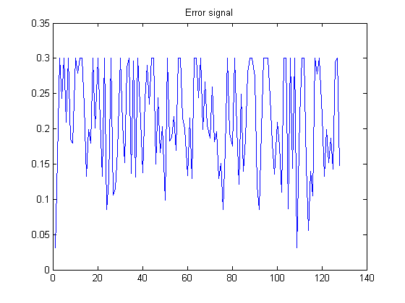
Results
Sample Result:
PAPR of Original Signal in dB 20.6920
PAPR of Clipped Signal 5.63 dB
MMSE = 0.0070

Slide 27
Selective Mapping
Set of Signals with phase shifts
Most favorable signal chosen
Side information → Complexity
Not removed peaks, but prevent it from frequently generation

Slide 28
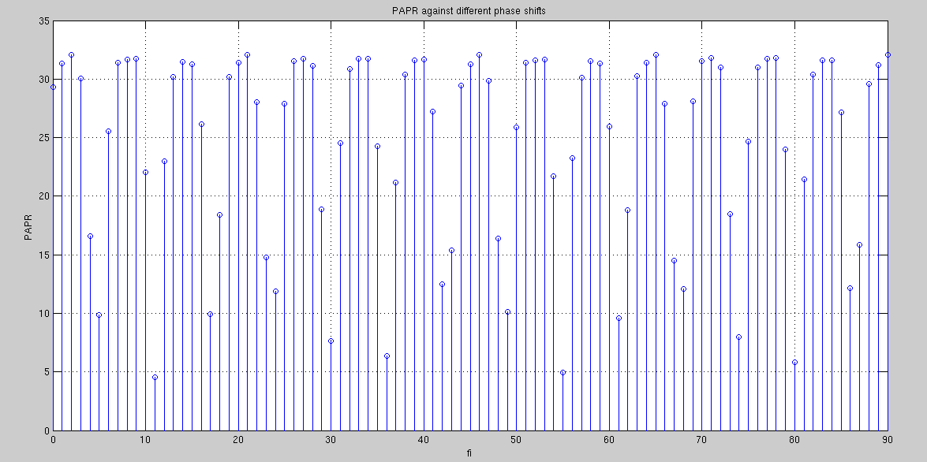
Results
Results obtained in SLM technique: Minimum @11 degrees

Slide 29
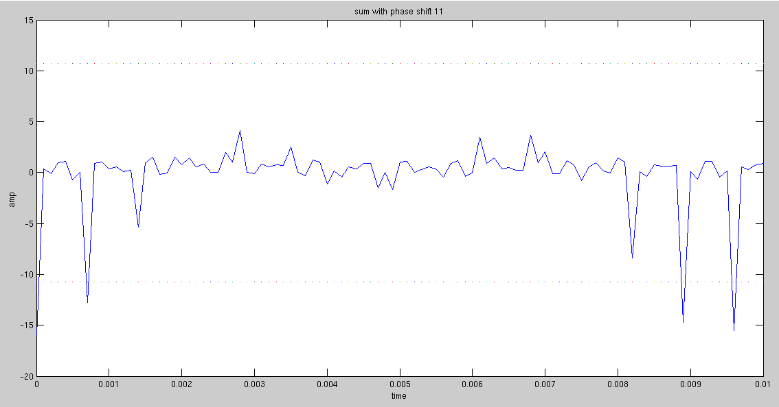
OFDM Signal with minimum PAPR for 11'o Phase shift

Slide 30
Tone Reservation
Includes set of peak reduction carriers
Combination of reserved tones → Creation of anti peaks
Amount of complexity
#of tones small → less peak reduction
        → less usage of BW

Slide 31
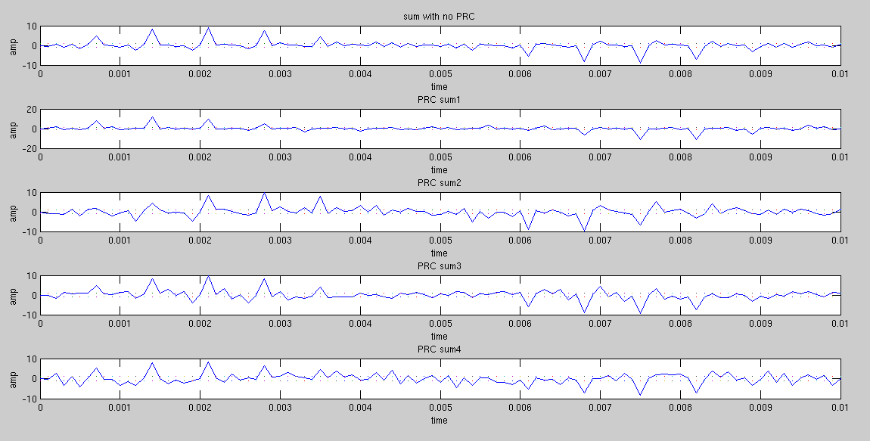
Results

Slide 32
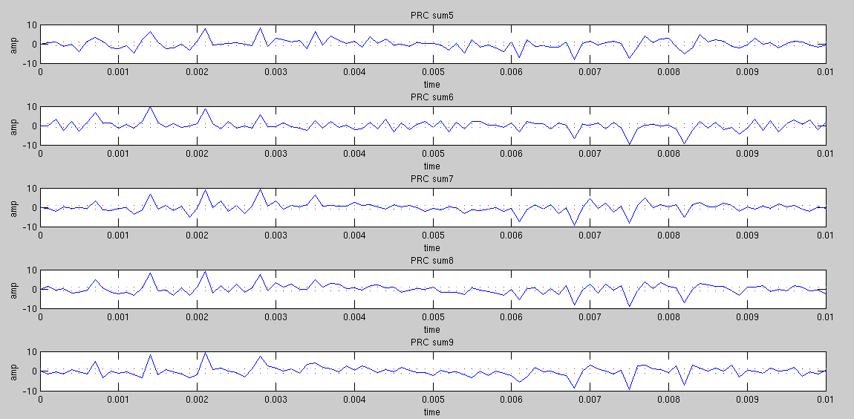
Results

Slide 33
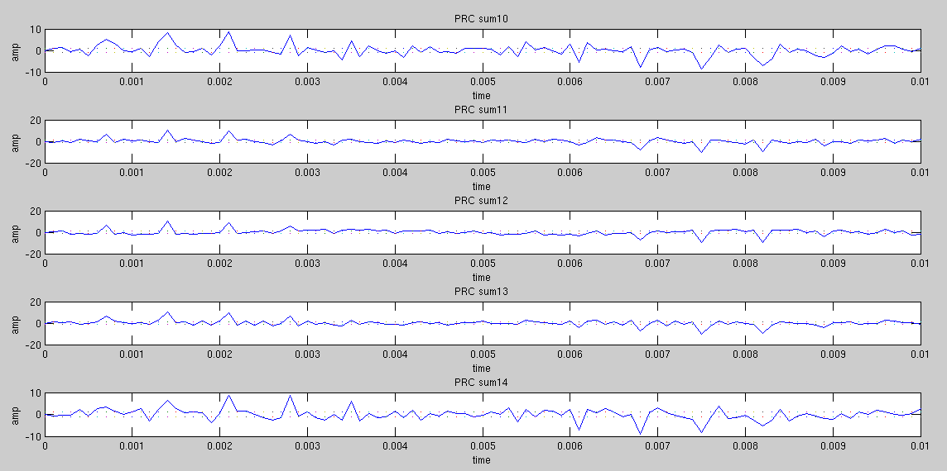
Results

Slide 34
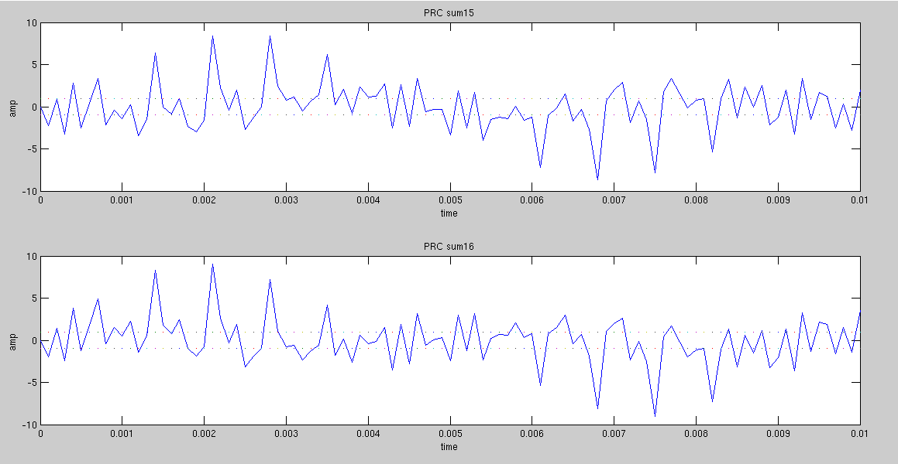
Results

Slide 35
Results
PAPR = 26.6393 PAPR9 = 24.5452
PAPR1 = 29.29 PAPR10 = 22.8342
PAPR2 = 25.8413 PAPR11 = 26.31
PAPR3 = 25.4080 PAPR12 = 25.7989
PAPR4 = 21.6240 PAPR13 = 26.0764
PAPR5 = 21.7348 PAPR14 = 23.2783
PAPR6 = 25.4585 PAPR15 = 22.1395
PAPR7 = 24.3934 PAPR16 = 23.4401
PAPR8 = 23.6455

Slide 36
Partial Transmit Sequences
Probabilistic based ← SLM
Divide into Non-Overlapping sub block
Sub carriers in each sub-block are weighted by phase factor for that sub-block
Interleaved partition, adjacent partition, random partition
No need to transmit SI → better performance

Slide 37
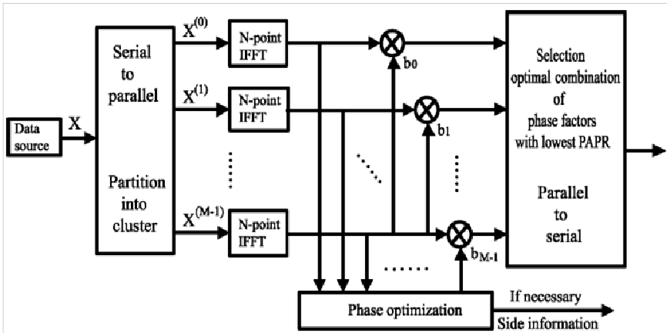
Block Diagram of PTS

Slide 38
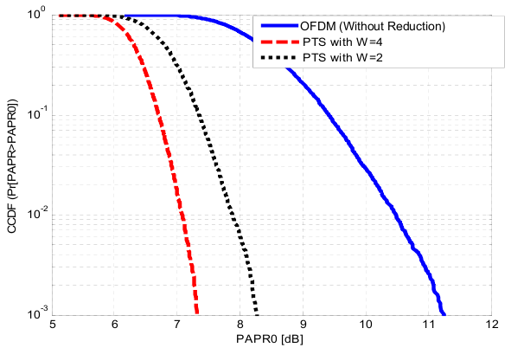
Results

Slide 39
Conclusions
Multi Carrier System – High Data Rate
Effective Digital Modulation for wireless communications
Major challenges – PAPR and ICI
Optimum technique for PAPR Reduction
Loss in data rate, transmit signal power, BER, Computational complexity – Major factors

Slide 40
References
[1] Arun Gangwar, Manushree Bhardwaj An Overview: Peak to Average Power Ratio in OFDM system & its Effect”International Journal of Communication and Computer Technologies, Vol 01-No.2, Issue:02 Sept 2012.
[2] Ramjee Prasad, OFDM for Wireless Communications Systems, universal personal communications.
[3] Ahmad R. S. Bahai, Burton R. Saltzberg, Multi-carrier digital communications Theory and applications of OFDM, Kluwer Academic / Plenum Publishers New York, Boston, Dordrecht, London, Moscow 1999.
[4] Nicola Marchetti, Muhammad Imadur Rahman, Sanjay Kumar, Ramjee Prasad, Chapter2. OFDM: Principles and Challenges.
[5] Dov Wulich, Lev Goldfeld, Gill R. Tsouri, Peak to Average Power Ratio in Digital Communications. IEEE Trasn. pp 779-782.

